Slide 1
Final Programming Exam Rules
Data Structures and Object-oriented Programming 2022 Spring
Professor: Sai-Keung Wong

Slide 2
Schedule
Final programming exam: 6/16(Thursday，星期四) 18:30~21:20
Exam range: All materials have been covered so far.

Slide 3
Information of School Policy
1. Due to the rise of the COVID-19 alert level, all on-site learning activities, including lectures, lab courses, exams, physical education, and qualification/thesis oral exams must be changed to online, suspended, postponed, or cancelled. Homework should be submitted online. Students of internship courses follow the regulation of the internship sites.
2. Suggestions for online exams:
a. Teachers prepare the problems on the E3 system for students to answer on the E3 system. Teachers upload the e-file of problems to the E3 system. Students answer the questions on paper and submit via picture(s).
b. Exam monitoring: Teachers or TAs will monitor all students during the exams via video conference. Students need to prepare cameras or smart phones and video themselves while taking exams online. Remind students to have a quiet and bright environment for the exams and camera angles should avoid areas containing test answers.
3. Teachers may adjust their assessment methods for the evaluation of learning activities in ways they see fit, while abiding by related regulations, such as physical paper reports, video clips, online demonstration of handcrafted works, honor exams without monitoring, etc.
4. Oral exams of qualification and thesis defenses must be conducted online via video conference. There is no need to apply for online oral exam beforehand. All committee members should participate in the online oral exam simultaneously. Individual college offices will help to collect the signatures of committee members for the official documents.
5. For lab courses and practical operation courses, online streaming or offline video demonstrating the lab experiments is recommended. Regarding lab equipment without safety concerns, teachers may decide whether students can borrow the equipment and do the lab experiment at home. Students may show their experimental results online. After completion of lab experiments, teachers should collect and sterilize all borrowed lab equipment.
6. Teachers should announce all adjustments to learning activities and assessments while maintaining the quality of teaching and learning standards

Slide 4
Rules - during the exam
The exam is online.
On the day of the exam, TA’s will announce the link of the google meet. All students must prepare webcam(or laptop, smart phone, etc.) for the online exam.
During the exam, the video should be able to show the upper body of you and surrounding. In the video, there shouldn’t be any item that is irrelevant to the exam. TA’s will record the video through google meet.
If there’s any question, we provide a google doc for you to ask questions.
We will announce an attendance sheet. You must sign your name or you will be considered absent.
You are allowed to refer to labs, assignments, teacher’s slides, textbook and your notes. If your own notes are online document, please print them out or download to your computer beforehand. You are not allowed to search online resources, or your score will be 0.

Slide 5
Rules – building environment
The exam files will be a zip file with password, make sure you can extract a zip file.
The exam files and password will be announced at the day of the exam.
You must implement the questions in the exam template.
The exam template we provide will be the Visual Studio 2019 project.
You must use Visual Studio (any version higher than 2019) to do the exam. If you use mac you can use Xcode instead.

Slide 6
Rules – screen recording
During the exam, students shouldn’t open the screen except for Google Meet, IDE, PowerPoint, labs and your own assignments.
During the test, everyone must record the screen(no sound is OK), You should record the video in several clips so that some unexpected events can be avoided(e.g., computer crashes and system shut-down). we provide 2 tools for you :
Open Broadcaster Software: https://obsproject.com/ (Recommend)
Power point screen recording: https://support.microsoft.com/zh-tw/office/%E5%9C%A8-powerpoint-%E4%B8%AD%E9%8C%84%E8%A3%BD%E8%9E%A2%E5%B9%95-0b4c3f65-534c-4cf1-9c59-402b6e9d79d0?fbclid=IwAR1KRFP5yyEDVHqNEl0uVzHdmkk7T5SUGLs1QwiFiInxSV6we2vN5RM-sPI
You can also use cellphone to record your screen.

Slide 7
Rules – submission details
All students must upload your StudentWork folder to E3 before 21:40. You can start to upload your solution at 20:30. Upload format: OOP_Final_ID_StudentName.zip (e.g. OOP_Final_109550000_王小明.zip)
You can only submit your file once during the exam. Please double check your file before you upload. After the exam time, you can submit your file more than once (but it will be treated as late submission).
All students must upload the following files to your Google Drive and upload the sharing space URL on E3 within a day after final exam (For example, in final programming exam, you should upload these files before 6/16 21:40.)
Photo of your student ID card or personal ID card.
Screen recording of the Exam. The length of the video should be at least 120 minute(18:30~20:30).
Remember to turn on sharing(set privacy as public) so that the TA can watch or download your video directly.
The name of the recorded video must be ID_StudentName.mp4 (e.g. 109550000_王小明.mp4)
The screen recording should at least stay in your drive for 2 weeks.

Slide 8
Rule – scoring criteria
There are four cases for scoring
If you upload the answer file:
Before 21:40, your highest score will be 100.
21:40 ~ 22:30, your score will be reduced by 40 points. (highest score will be 60)
After 22:30, your score will be 0.
You have 20 minutes(21:20-21:40) to upload your file, after that any file uploaded on e3 will be considered late submission.
If your screen recording length is more than 120 minutes, your score won’t be reduced.
If not, your score will be: yourOriginalScore – (40 * (120 - videoLength)/120)

Slide 9
Rule – scoring criteria
If you do not sign your name on the attendance sheet, your score will be reduced by 10 points.
If you do not turn on webcam or camera, your score will be reduced by 10 points.
If you do not record the whole screen, your score will be reduced by 10 points.
If you do not upload your recording on the google drive, your score will be reduced by 10 points. Please do not upload zip file.

Slide 10
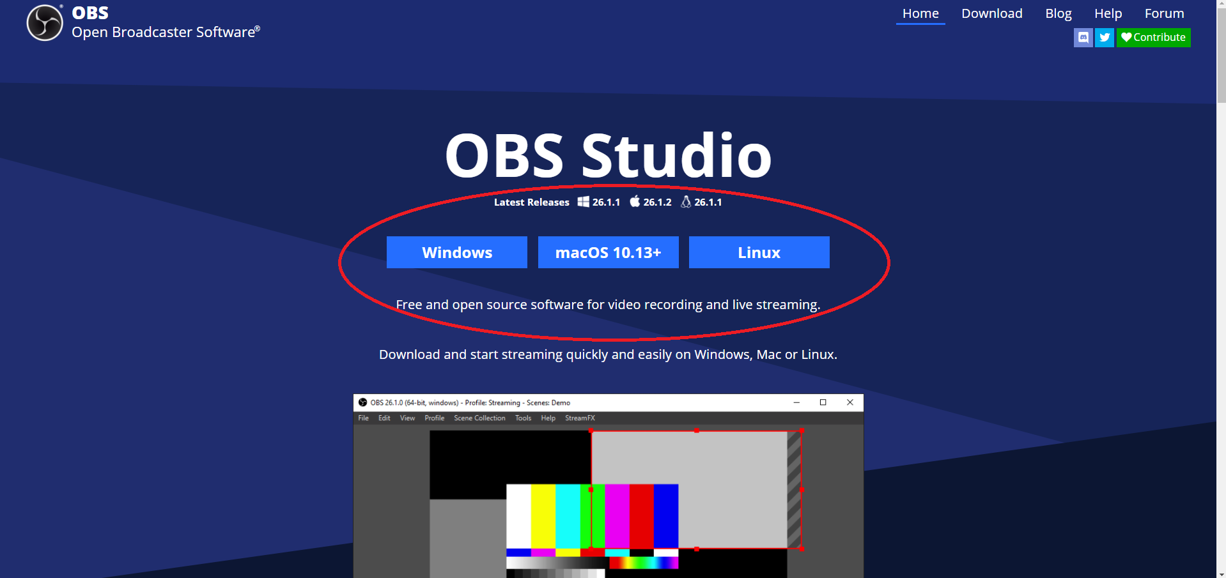
Open Broadcaster Software tutorial
Download: https://obsproject.com/

Slide 11
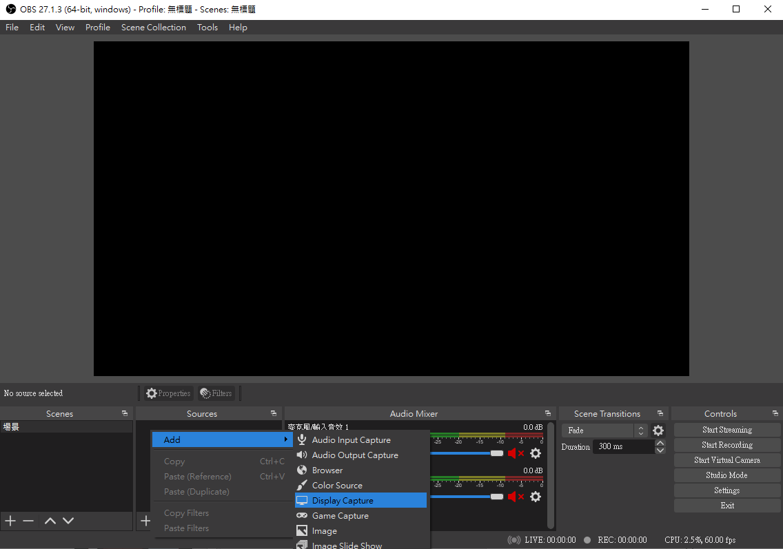
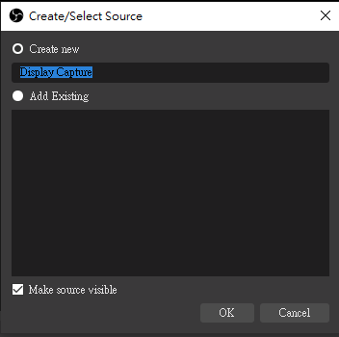
Open Broadcaster Software tutorial
1. Right click at Source -> Add -> Display Capture
2. Press OK

Slide 12
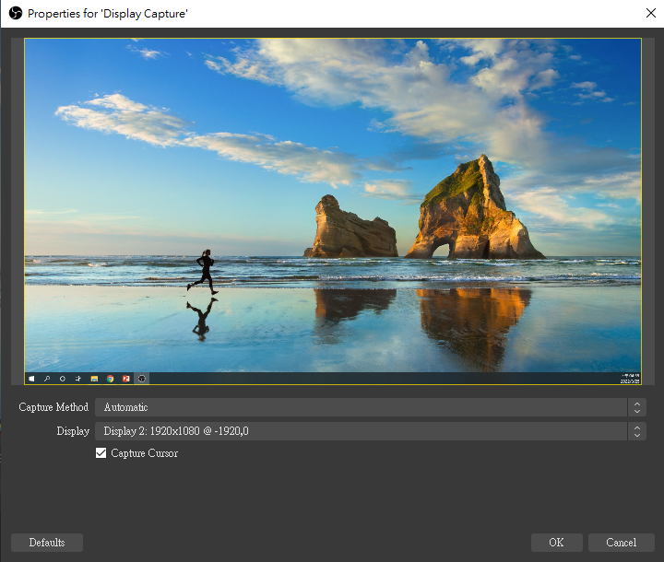
Open Broadcaster Software tutorial
3. Press OK
Your Display Here

Slide 13
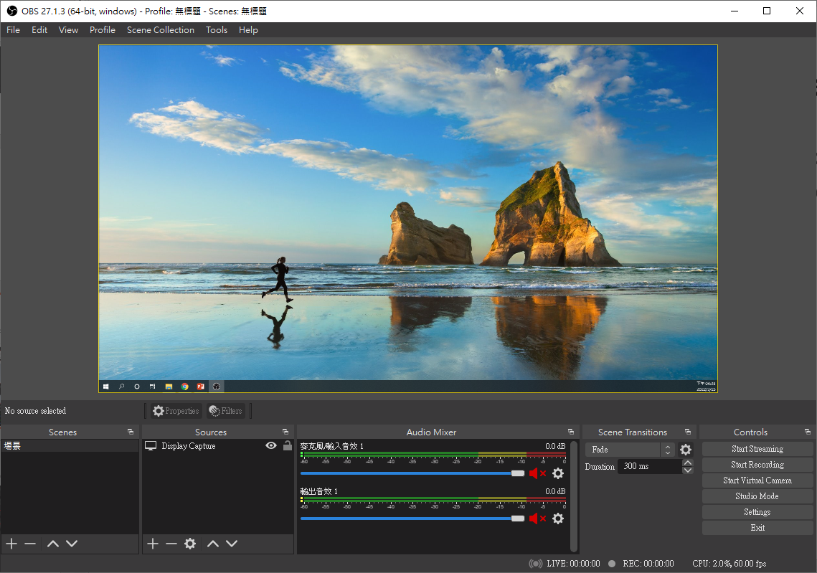
Open Broadcaster Software tutorial
If the picture of your screen is shown in the middle screen of OBS，Click “Start Recording" to start recording the screen

Slide 14
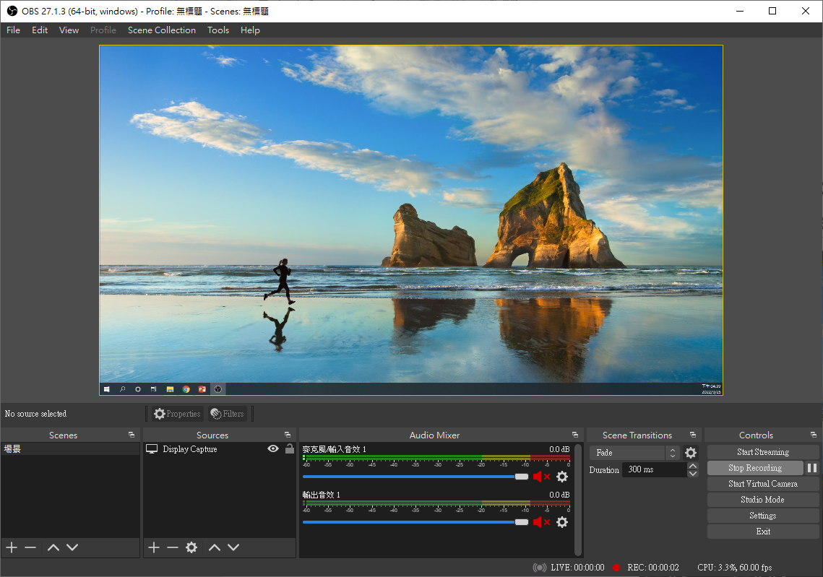
Open Broadcaster Software tutorial
To finish recording and save, click " Stop Recording " .

Slide 15
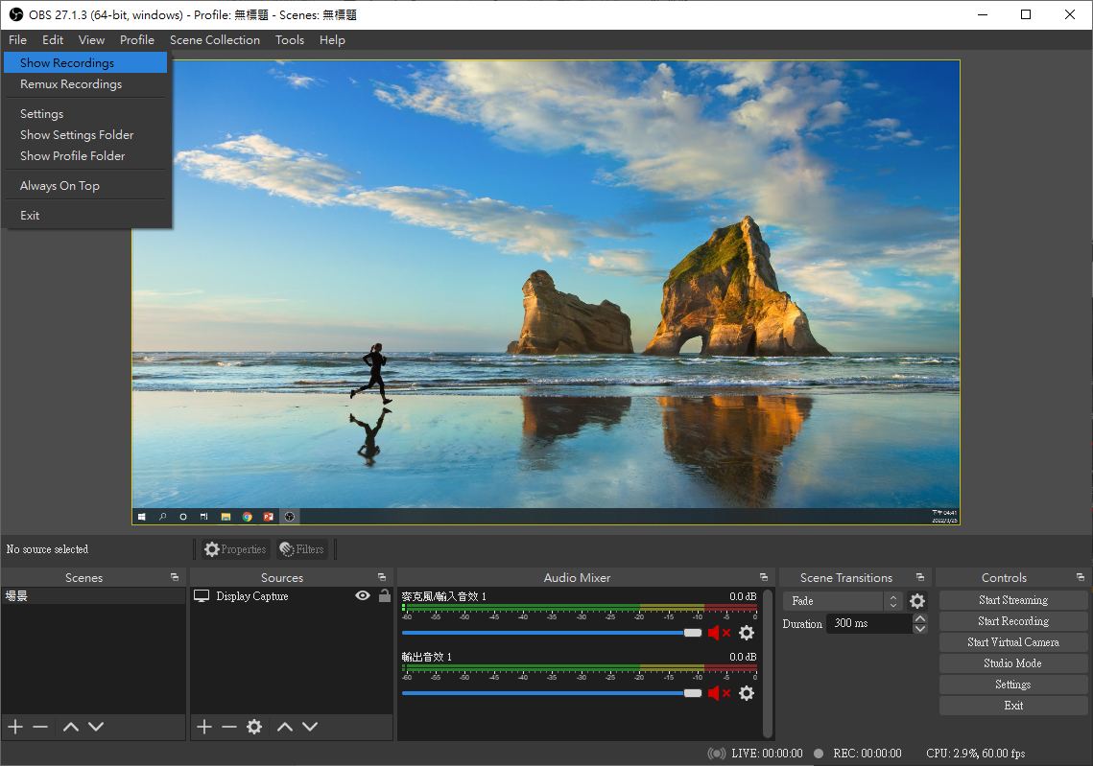
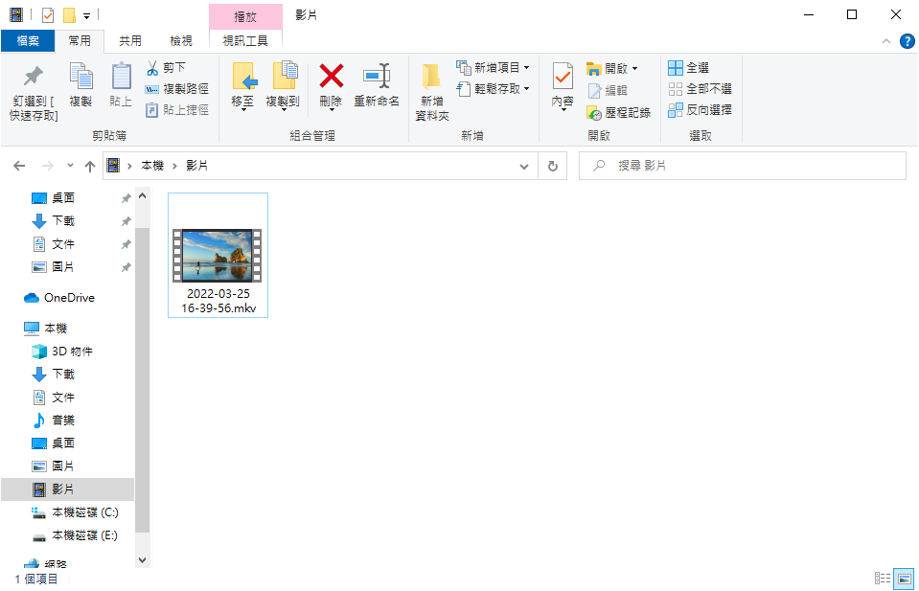
Open Broadcaster Software tutorial
The recorded video can be found at File -> Show Recordings

Slide 16
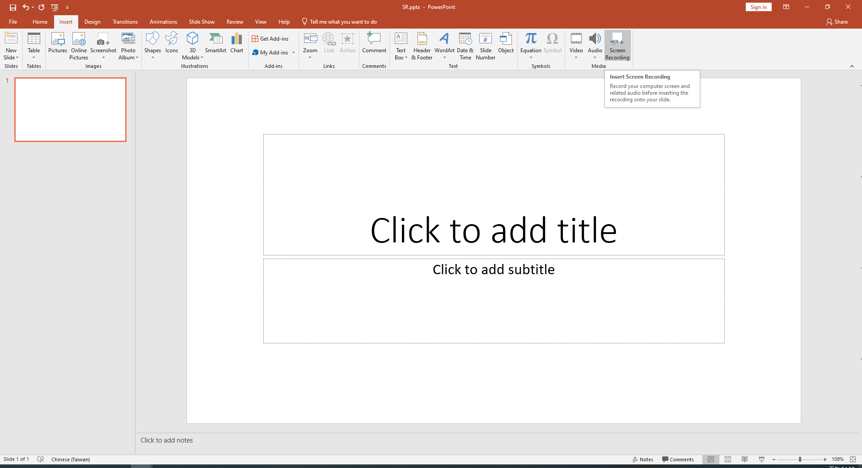
PPT screen recording tutorial
1. Create a new PPT file. Choose Insert->Screen Recording

Slide 17
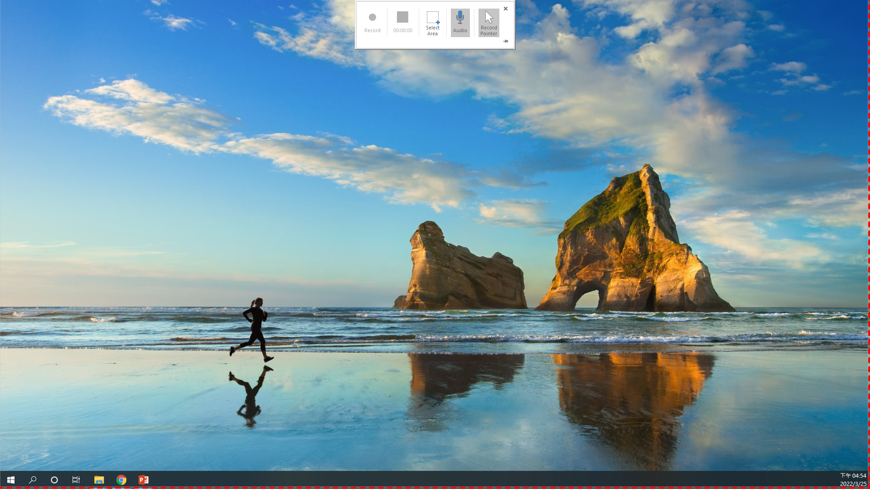
PPT screen recording tutorial
2. Select whole area of your screen. Remember to toggle record pointer

Slide 18

PPT screen recording tutorial
2. Press record after selecting screen area

Slide 19

PPT screen recording tutorial
2. Press Stop record button (the blue square) to stop recording

Slide 20
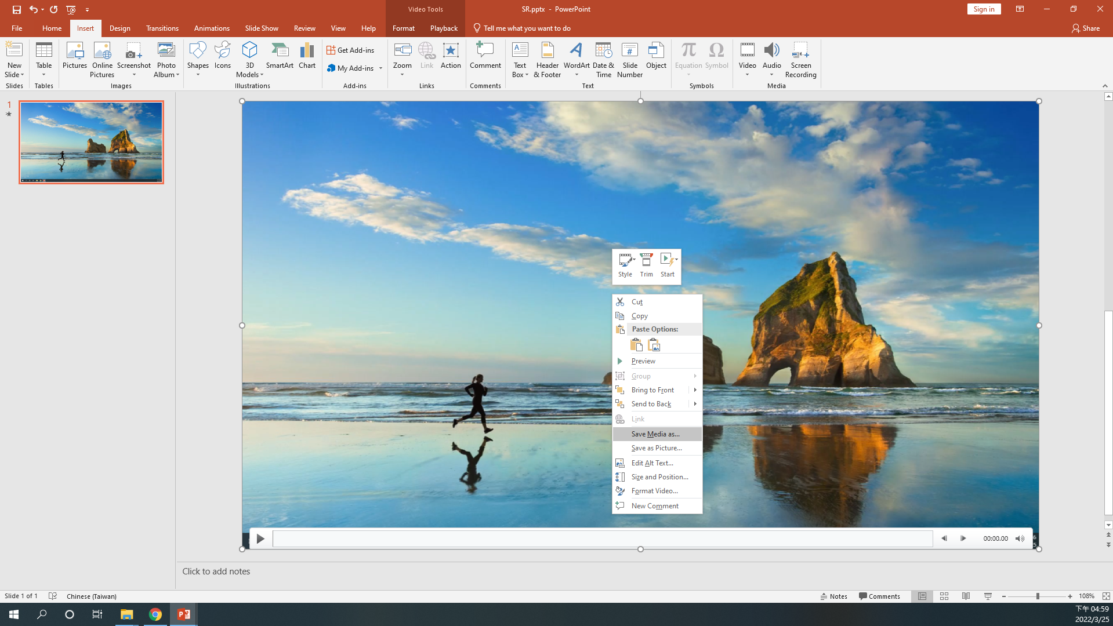
PPT screen recording tutorial
2. Back to PPT, right click on the video -> Save Media as

